Slide 1
Determining Correlation between National Election outcomes with Religion, Race, and Education
Henry Hopley
Colorado Status University – Global Campus
Notes:
My name is Henry Hopley and I am speaking today to discuss how the DNC and other major Democratic party organizations can improve their candidate selection process during primary and general elections.

Slide 2
Objective
To determine if there is a correlation between various religions, races, and education levels in the results of national elections.
To provide actionable insight on how results could be used in finding the right candidate and campaigning.
Notes:
Now, my objective here today is twofold. First, I would like explain the process I undertook to discover if there was a significant correlation with specific characteristics of counties in the United States and the winner of the 2012 and 2016 presidential election. Second, I will be sharing how this information can be used immediately as well as potential next steps that could be taken from this point to learn more actionable insight that could help win elections for the Democratic Party. Following scientific research processes, I created a set of hypotheses.

Slide 3
Research Hypothesis
H₀: There is no combination of characteristics that help predict which way a county will vote.
H_{a}: There is a combination of characteristics that help predict which way a county will vote.
Notes:
These hypotheses consisted of a null hypothesis and an alternative hypothesis. The null hypothesis reads; There is no combination of characteristics that helps predict which way a county will vote. I will be using a dataset containing county-level statistics about religion, education, race, party-affiliation, and how rural or urban a county is. Being able to reject the null hypothesis will allow me to accept the alternative hypothesis, which reads; There is a combination of characteristics that help predict which way a county will vote. But who are you and why should you care?

Slide 4
History of The Democratic Party
The Party of Jefferson
Woodrow Wilson’s Economic Reforms
FDR and the New Deal
Civil Rights Act of 1964
Barack Obama
2016 and the 2018 Blue Wave
Notes:
The Democratic Party is the oldest political organization in U.S. history. While it is virtually unrecognizable from its origin, it began as the Republican Party of Thomas Jefferson. This party advocated for a decentralized government with very limited powers (“Democratic Party | History, Definition, & Beliefs | Britannica,” 2020). There are a number of twists and turns, including multiple parties with the title of “Democrat” before a recognizable party forms that exemplifies the brand of federal regulation of private industry for the benefit of the majority.
Near the beginning of the 1900’s, Woodrow Wilson “championed various progressive economic reforms, including the breaking up of business monopolies and broader federal regulation” (Democratic Party | History, Definition, & Beliefs | Britannica 2020). These beliefs were not widely appreciated and Democrats were unable to hold on to power until Franklin D. Roosevelt won election in 1932. Franklin Delano Roosevelt, or FDR, was the father of the New Deal, a large number of social programs that helped revitalize the United States during the Great Depression.
The next large milestone of note for the Democratic Party was the passing of the Civil Rights act of 1964. While an enormous step forward for an otherwise regressive country, the actions taken by Lyndon B. Johnson to pass this act resulted in a loss of support from southern Democrats over the next 20 years.
Finally, in 2008, Barak Hussain Obama was elected as the first black President in the history of the United States. His 2008 and 2012 campaigns introduced historic numbers of new voters from demographics not typically considered worth the investment. His grassroots organization has been adopted and expanded in a glorious fashion in recent years, most notably in harsh backlash to the 2016 upset election of Donald Trump.

Slide 5

The Democratic National Committee
Founded in 1848
Primary Duties
Democratic Presidential Nominating Process
The War Room
Organizing Corps 2020
Data and Technology Resources
Civic Engagement
Notes:
There are a number of organizations that were created throughout the history of the Democratic Party. These organizations include the Democratic National Committee (DNC), in charge of electing Democrats to the office of President. There is an additional committee for each major office, including the House of Representatives (DCCC), the U.S. Senate (DSCC), Governor’s races (DGA), and local elections (ASDC).
Founded in 1848, the duties of the DNC most notably revolve around supporting the Democratic presidential candidate. This involves assisting with creating the national platform, setting up debates during the primary and holding the Democratic National Convention.
Since this is the most news-worthy position in the United States, the DNC also able to hold vast resources that it uses to support down-ballot races across the country. The war-room is a unit created to fund research, communication, and mobilization efforts that are accessible by state parties, candidates, and activists (What we do, 2019). They have created Organizing Corps 2020, which goes to battleground states and teaches activists how to organize get out the vote efforts. Their vast resources also include data and technology which are made available to down-ballot campaigns in order to properly organize grassroot efforts with the right information. With all of this at hand, how could I help them become even stronger?

Slide 6
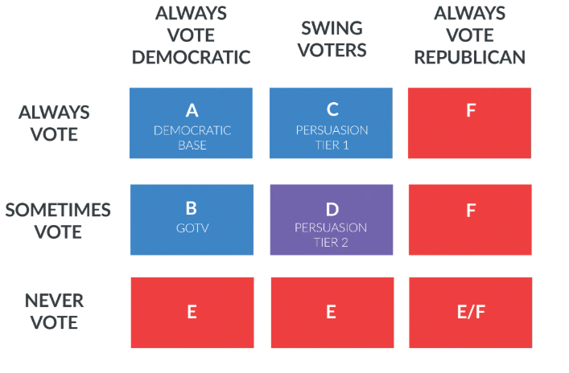
How Did I Get Here?
Canvassing for my local Congressman, I learned about target voters
The loss of Christy Smith in California’s 25 Congressional District
How?
Religion influences Politics influences Religion
How can you determine support for Trump?
Are there other characteristics that could be used to pick a candidate?
Notes:
Now how could I ever help such a large and powerful organization such as the Democratic party? In my own congressional district, I canvassed for one candidate and also received marketing material from a primary challenger. Through canvassing and using NGP VAN, I learned that there are essentially only three groups out of nine that are targets for campaign volunteers. Swing voters that always vote, swing voters that sometimes vote, and Democratic voters that sometimes vote. Upon looking at the two main primary candidates I wondered how a large organization would know which candidate to support? Further investigation revealed other candidates that should not have made it as far as they did on the platform they chose. Alexander Sammon of the American Prospect discusses how Christy Smith lost a house seat in California’s 25 congressional district this year when Katie Hill won it in 2018 on a platform including Medicare for All when Smith wouldn’t support it. Alexandria Ocasio-Cortez primaried Joe Crowley and beat him by having a platform that excited the constituents in her district.
All this tells me is that election winners on the Democratic side, have strong platforms that excite the voting base and bring out the “sometimes” voters. This is all great, but how does one know what is important in an individual county? It is known that religion influences politics and (Patrikios, 2008) shows that politics influences religion right back. A Review of the Popular and Scholarly Accounts of Donald Trump’s White Working-Class Support in the 2016 US Presidential Election shows that education levels also indicate if a person is working class (Thompson, 2019). Knowing religion and education influence how a person will vote, leads me to question if those demographics can be used to predict how a county will vote in a presidential election? Could predictive models show a connection with these characteristics and the winner of a county?

Slide 7
Project Approach
Finding a Dataset
Registered voters
Counts of religious adherents
Levels of education and land description
Merging and Sanitizing Data
Python and the pandas library
Manual data cleansing
Notes:
In order to perform a regression model against the various characteristics that I focusing on, I had to combine multiple datasets. Each one was used on its own to show various statistics and each one was set at a county-level granularity. This was done through the Federal Information Processing Standards (FIPS) code where the first two digits represented the state and the following digits represented the county either two digits or three depending on the state. Using the FIPS code as the primary key for all three datasets, I was able to merge them together using the pandas library in Python. After the merge, I had to manually clean the data so that it could be read into SAS Studio without throwing exceptions.

Slide 8
Project Approach (Cont.)
SAS Data Exploration
SAS Univariate procedure
SAS Data Modeling
Regression Testing
Notes:
I used four regression models to discover how much of an effect each characteristic has on the winner of two past national elections, 2012 and 2016. I manipulated my multiple linear regression models to narrow it down to only variables that had a significant effect on my independent variable, the number of people who voted for the winning candidates, Barack Obama, and Donald Trump. Once I had the variables that showed a significant correlation, I applied them to the losing candidate from the same party. If there is a correlation between these characteristics, I will be able to reject my null hypothesis.

Slide 9
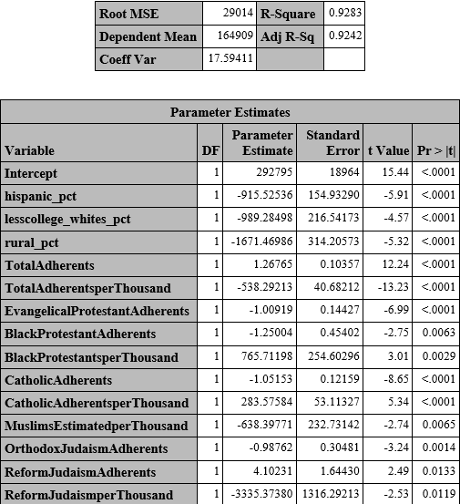
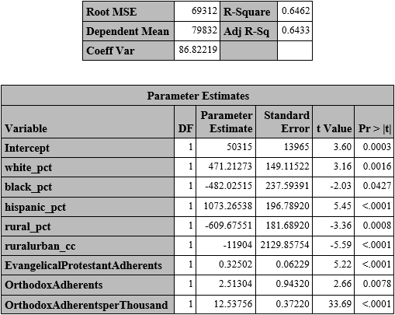
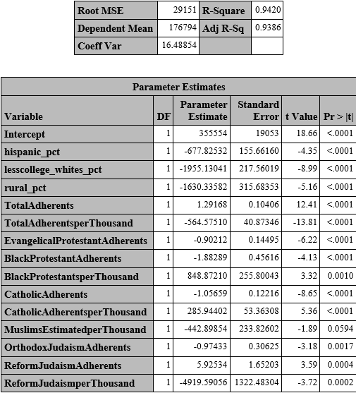

Findings
Obama
Trump
Clinton
Romney
Notes:
There were 14 variables that were shown to be significant in finding a correlation with the target variable of voters per county for Barack Obama in 2012. 11 of them were different measurements of religious adherents while the others described education levels, the percent of the county that was considered rural, and the percentage of the county that was Hispanic. These variables were all < .05, ranging from <.0001 to <.0133. The R-Squared value for this model was .9283, indicating that 92.83% of the numbers for Obama in 2012 can be explained by the numbers in the independent variables. These independent variables were then applied in a multiple linear regression against the turnout numbers for Hilary Clinton, returning similar results. All but one of the variables used in the first model returned p-value of < .05. Muslims estimated per thousand returned a p-value of .0594 which is just over the significance level of .05. The R-Squared value for this model was .9420, slightly higher than that returned in the prior model.
The number of variables that accurately predicted the turnout for Donald Trump was smaller than the two Democratic candidates. There were only 8 variables that had significance level of < .05, ranging from <.0001 to <.0427. Three represented religious adherents, and the other five related to race and the percentage of rural voters. The R-Squared value for this model was .6462, indicating that 64.62% of the variance of Trump’s turnout numbers could be explained by the significant variables. This list of variables was applied to Mitt Romney’s turnout numbers and all variables returned p-values of <.05. The R-Squared value for this model was .6815.

Slide 10

Conclusion
Rejected: H₀: There is no combination of characteristics that help predict which way a county will vote.
Accepted: H_{a}: There is a combination of characteristics that help predict which way a county will vote.
Challenges:
Public data Missing and un-sanitized
Bias in subject
Notes:
Based on the results of the four models ran, there are significant variables that correlate with the numbers for all four presidential candidates. This leads me to reject my null hypothesis and accept my alternative hypothesis. It was important to test characteristics against the candidates individually in order to predict the outcome of a county for the democratic candidate. While there might be some benefit in finding a set of characteristics that could predict candidates on both sides of the aisle, the priority according to NGP VAN is to focus on undecided voters and low-engagement voters (Weiss, 2018). With that in mind, two sets of variables were able to show a strong correlation with the voter turnout in a county and the larger one occurred under the “Big Tent” party, further solidifying the idea that there are many different groups of people that are needed for a Democratic candidate to win the White House.
My primary challenges revolved around data. First, lots of data involving individual voting habits is private and political parties have to purchase the data in order to further break it down into actionable information. The amount of publicly available data is somewhat limited and often posted by data enthusiasts. While there is a strong chance the source of the data is legitimate, it can be difficult to truly verify the authenticity of the data. When I found one dataset from data.world, I looked into the publisher’s other postings and history. He seemed to be a trusted individual who had a strong rating and over 100 other datasets that were in use on the website. With no ulterior motive seen, I trusted the data but must be aware that it might have errors that would put the results into question.
Other challenges related to the states themselves. There are many states that do not keep detailed public information about their voters. This led to multiple variables being unusable because they had large blank spaces. I initially wanted to include demographics on the number of registrations for each party but with so many blank spots, my regression skipped the rows and I was forced to take them out of my models.
In going through this process, there was bias that must be mentioned. I am a member of the Democratic party and assist my precinct chair with get out the vote efforts. I fully believed that the characteristics would have an effect on voter turnout and made every effort to prove myself wrong. In prioritizing the desire to have a successful project over proving myself correct, I believe I kept my personal beliefs from affecting the results.
In spite of the missing data I believe I received a fair sample size that justifies the results of the models and invites further action in the future.

Slide 11
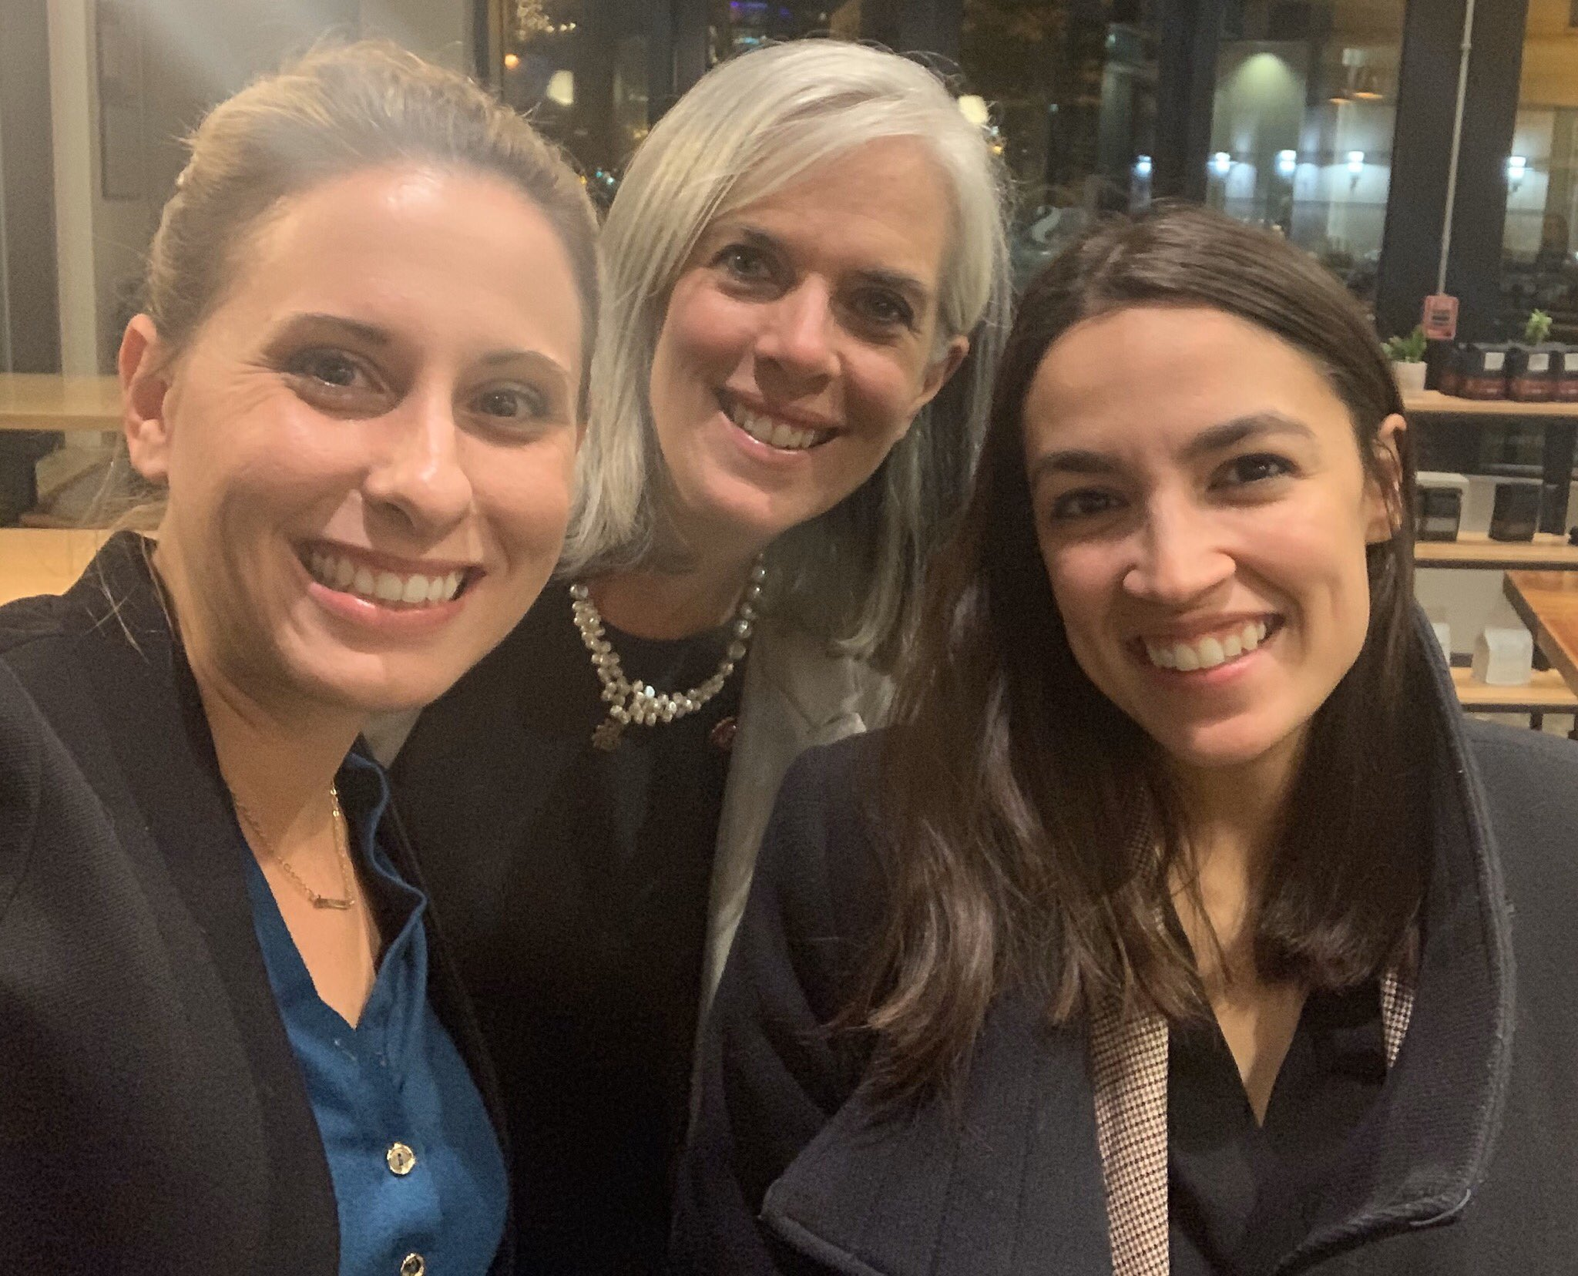
How Does this Help?
2018 Blue Wave provided more options
Deciding between Katie Hill and Christy Smith in CA25
Enthusiasm for Alexandria Ocasio-Cortez
Knowing what policies are valued highest in a local election could help large organizations select candidates to support that have most local support as well!
Notes:
There are many indications that change is occurring in the Democratic party. 2018 had the highest number of candidates for congress since the Federal Election Commission began tracking in 1977 (Weiss, 2018). Katie Hill won California Congressional district 25 and Alexandria Ocasio-Cortez or AOC, beat out a multi-term incumbent believed to be in the fourth highest position in Congress. Candidates like AOC did not have the support of big organizations but won regardless because the voters of her district believed in her over Joe Crowley. In order to truly be able to represent each district most effectively, a model such as this could be critical in finding out which policies are most important and which candidates embody those policies the most. Using this information would help an organization such as the DNC to support the right individual and avoid losing house seats like in California 25 because the supported candidate had a platform that wasn’t popular in her district. On top of this immediate knowledge, there is always more work that can be done.

Slide 12
What’s Next?
Improve dataset
Purchase or collect higher quality data
Increase detail by focusing on individual counties
Ask new questions
Which is more important, characteristics of a county, or policies that excite low-propensity voters?
Can they be combined?
Notes:
The first step to improving on this model are to improve the dataset. This could easily be done using the purchased data that the DNC and state parties have. This data would be of a higher quality, allowing for a stronger model and more reliable information on a much smaller granularity. Shrinking the model down to a specific district would allow specific information to be shown that would highlight the policies that the ideal candidate should support and promote.
The goal is to get out the vote. To do that you need a candidate that supports the values of the community they represent and promotes those policies in a way that excites those constituents that are needed to earn a majority of the vote. This model shows that public data can provide some of that insight and with modifications and improvements, can help large organizations support the winning candidate every time.

Slide 13
References:
(2019). What we do. Democrats. https://democrats.org/who-we-are/what-we-do/
‌KatieHill4CA. (2019, December 4). Excited to work with my friends @AOC and @KatherineClark to fight cyber exploitation. When women join forces, we’re unstoppable. Purple heart [Tweet]. https://twitter.com/KatieHill4CA/status/1202414656486162433/photo/1
Sammon, A. (2020, May 18). How Democrats Lost a House Seat in California. The American Prospect. https://prospect.org/politics/how-democrats-lost-a-house-seat-in-california/
Saad, L. (2020, January 9). The U.S. Remained Center-Right, Ideologically, in 2019. Gallup.Com; Gallup. https://news.gallup.com/poll/275792/remained-center-right-ideologically-2019.aspx
Steiger, K. (2018, June 27). Rep. Joe Crowley’s shocking primary defeat to Alexandria Ocasio-Cortez. Vox; Vox. https://www.vox.com/policy-and-politics/2018/6/26/17506970/alexandria-ocasio-cortez-joe-crowley-primary-new-york
‌Weiss, B. (2018, March 3). A record number of people are running for Congress this year - Business Insider. Business Insider; Business Insider. https://www.businessinsider.com/2018-midterms-candidates-against-trump-democrats-2018-3
Wilson, C. (2017, May 17). Here’s the Election Map President Trump Should Hang in the West Wing. Time; Time. https://time.com/4780991/donald-trump-election-map-white-house/
‌

